Slide 1
Certificate in Digital Applications – Level 02
Website Design and Creation
Unit 01 – Website Development
ICT Dept

Slide 2
Assignment Scenario
Assignment
Checklist
LO1
LO2
LO3
LO4
CLIENT BRIEF – prepared by the manager of Smarts Leisure Park
Smarts Leisure Park already has a company website. We want to add a microsite for under-18s that promotes their shop and clubs that will be added to the main site when the pages are complete.
Overall site requirements:
three main pages – a home page, a page about the shop and café, and a clubs
introduction page which has links to two club pages (Kidz Club and Teenz Club)
a colour scheme that reflects the woodland setting of the leisure park
pages to include suitable titles and appropriate text
facts about the park to be taken from the file INFO.txt, but text may be edited
images to be taken from the folder ASSETS, but may be edited
content must be visible without scrolling at a resolution of 1024 x 768
accessibility features for visually impaired visitors should be included
a consistent design across the microsite, including a page template applied to all pages

Slide 3
Assignment Scenario
Assignment
Checklist
LO1
LO2
LO3
LO4
Other requirements:
Page template – a banner which is the full width of the page and includes:
suitable text
the Smarts logo, linking to www.smartsleisurepark.co.uk
a navigation bar for the main pages
File formats – images to be in .jpg format and less than 350 KB
audio files to be in .mp3 format
Thumbnails – on the clubs introduction page, linking to Kidz Club and Teenz
Club pages
Map of the park – on the home page, edited to draw attention to some of the
locations and/or activities featured in the microsite
Shop products – on the shop and café page, a graphical link that:
shows any one of the products on sale
links to an image showing a range of products available
Onion café menu – on a suitable page
Contacts – email links where appropriate
Audio introduction – embedded on a suitable page, plays only on click
Clock – a real-time clock on a suitable page, using the code in the file CODE.txt and the applet in the folder CLOCK

Slide 4
Learning Outcome 1 – Assignment
LO1: Be able to Design a multimedia website
You need to complete the following tasks in order to effectively help Smarts Leisure Park.
1 | To achieve a pass grade: Candidates will produce a brief proposal for a website. This will include some details of purpose and target audience. They will produce a site plan, basic house style and simple page plans for five web pages showing a possible link system between them. The page plans may not always be accurate. To achieve a merit grade: Candidates will produce a detailed proposal for a website. This will include purpose and target audience details. They will produce a site plan, a suitable house style and accurate detailed plans for at least five web pages showing more than one way to link the pages together. To achieve a distinction grade: Candidates will produce a comprehensive proposal for a website. This will include purpose and target audience They will produce a site plan, a detailed house style and accurate, detailed plans for at least five web pages showing links, colour scheme and multimedia components.
1
What a website is used for The kind of user for a website What the user hopes to achieve What a business hopes to achieve The kind of content a site holds. How a business can benefit from a website

Slide 5
Learning Outcome 1 – Task 1
LO1: Be able to Design a multimedia website
Smarts Leisure Park is situated in a forest near Southampton. It offers a range of activities
such as cycling, canoeing and nature trails.
Think about what a company hopes to achieve Who (NB: Corporate Groups). Why (Events, Team building, Educational). How will it benefit the company? Indication of how their message will b.seen Well discussed and detailed (M/D) Thorough Description (D) ALL Content Appropriate (D)
Task 1 (P, M, D) Smarts Leisure Park would like you to produce a proposal for their new website which they will hope to allow their customers the ability to book online and save time and money for the company.
1 | Identify the purpose and audience for the new Smarts Leisure Park website.

Slide 6
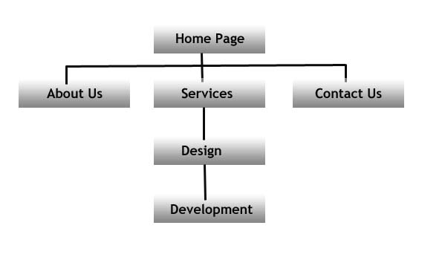
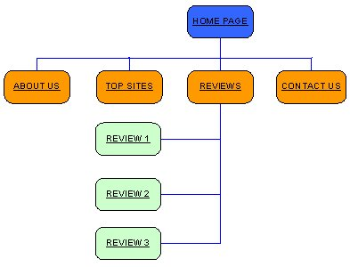
Learning Outcome 1 – Task 2
LO1: Be able to Design a multimedia website
Smarts Leisure Park is situated in a forest near Southampton. It offers a range of activities such as cycling, canoeing and nature trails.
Flow diagrams How the user moves from page to page Alternative pathways Ease of Use (M/D) Logical Pathing (M/D) Well Structured Layout (D) ALL Appropriate (D)
Task 2 (P, M, D) Now that the proposal has been agreed, Smarts Leisure Park would like to see how the pages are likely to link together so that they can tell if the user will be able to successfully navigate through the pages.
2 | Produce a Site plan with details of at least five pages shown
 | Provide details of how the user will navigate between the pages

Slide 7
Learning Outcome 1 – Task 3
LO1: Be able to Design a multimedia website
Smarts Leisure Park is situated in a forest near Southampton. It offers a range of activities such as cycling, canoeing and nature trails.
Location of elements Font, size and colour of text Logo Page Heading Location and type of buttons Clear indication of layout (M/D) Additional elements like external links or contact details. (D) Site map (D)
Task 3 (P, M, D) Now that the proposal has been agreed, Smarts Leisure Park would like to see how the pages are likely going to be similar in layout to each other. They would like to see a design for the template file, called the house style page, this should indicate where the buttons are, the logo, the fonts, the text size and text colour will be, where the images will be placed etc. This should reflect the webpage layout as much as possible.
3 | Create an annotated document showing a suitable house style.
 | Merit and Distinction
3 | Make sure that your design is detailed enough to demonstrate a professional layout and capable of being produced.
 | Distinction
3 | Additional features that are consistent on each page

Slide 8
Learning Outcome 1 – Task 4
LO1: Be able to Design a multimedia website
Smarts Leisure Park is situated in a forest near Southampton. It offers a range of activities such as cycling, canoeing and nature trails.
Location of elements Font, size and colour of text Logo Named images Clear indication of elements (M/D) Appropriateness of Layout (M/D) Additional elements like external links or contact details. (D) Site map (D)
Task 4 (P, M, D) Using the template file created from the previous task, Smarts Leisure Park would like to see the designs for the five pages. They would like an indication of elements that you plan to have on each page.
4 | Create an annotated Page Plan for each page showing the location of the elements for your Website.
 | Merit and Distinction
4 | Make sure that your designs are detailed enough to demonstrate a professional layout and capable of being produced.
 | Distinction
4 | Additional features that are consistent on each page.

Slide 9
Learning Outcome 1 – Task 5
LO1: Be able to Design a multimedia website
Smarts Leisure Park is situated in a forest near Southampton. It offers a range of activities such as cycling, canoeing and nature trails.
ALT Tags will take 30 seconds to add Limiting down size of the options Ease of use Consideration of customers needs (M/D) Sound Understanding of choices (M/D) Thorough Understanding of options (D)
Task 5 (P, M, D) You need to understand the importance of making your web products accessible to people with visual impairments. You will learn how to improve the accessibility of products by: avoiding colour combinations such as red and green on your web pages using a high contrast between text and background adding ALT (alternative) text to images using scaleable fonts.

Slide 10
Learning Outcome 1 – Task 5
LO1: Be able to Design a multimedia website
Smarts Leisure Park is situated in a forest near Southampton. It offers a range of activities such as cycling, canoeing and nature trails.
ALT Tags will take 30 seconds to add Limiting down size of the options Ease of use Consideration of customers needs (M/D) Sound Understanding of choices (M/D) Thorough Understanding of options (D)
Task 5 (P, M, D) Smarts Leisure Park managers realise that in order to appeal to a wider audience and not alienate their customers they will need to add accessibility options to their website. There is a range of options they can choose that help their customers such as Text Size Changer, High Visibility buttons, Language Changer, a Site Map, and ALT Tags.
5 | Create a Page Sketch indicating which Accessibility Options you will include on your finished pages.
5 | Realistic choices of Accessibility Options.
5 | Clear indication of appropriate images collected with a clear website structure.

Slide 11
LO1 – Assessment (P, M, D)
Task | Activities | Student | Staff
LO1 Design a multimedia website
1(P/M/D) | Identify the purpose and audience for the new Smarts Leisure Park website.
2(P) | Produce a Site plan with details of at least five pages shown
3(P/M/D) | Create an annotated document showing a suitable house style.
4(P/M/D) | Create an annotated Page Plan for each page showing the location of the elements for your Website.
5(P/M/D) | Show evidence of collecting and storing at least two images for your website.

